Slide 1
Detecting falls as OODs
Debaditya Roy, KTH/Qamcom Research and Technology

Slide 2
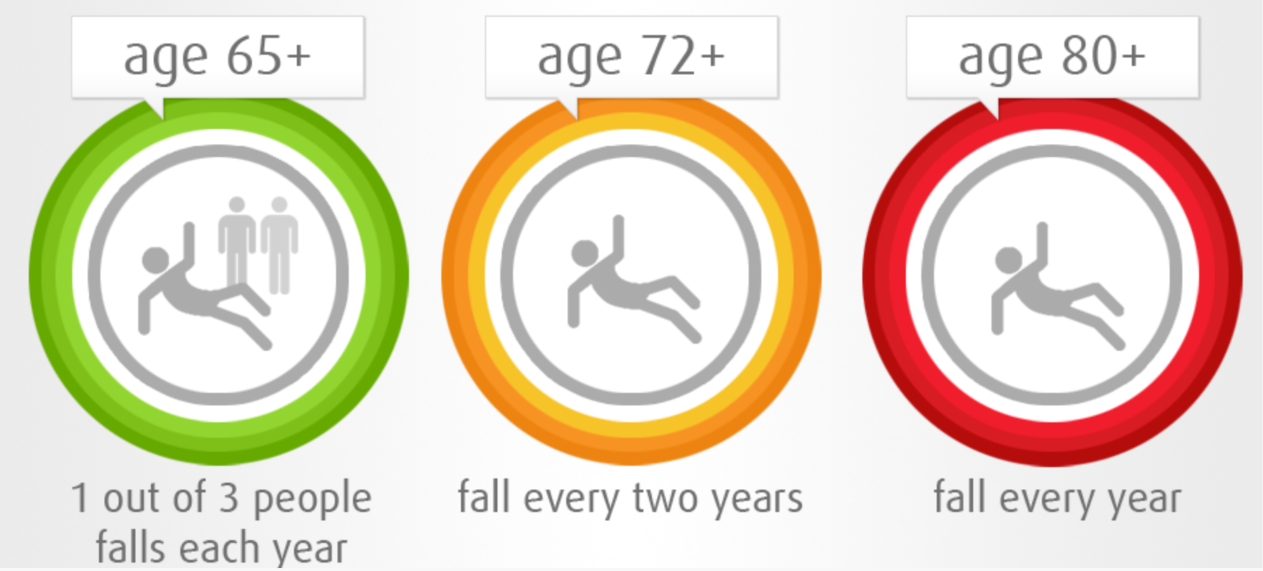
Detecting falls in time might save a life
Second leading cause of unintentional deaths. [3]
~ 36 million falls resulting in 3000 deaths. [4]
> 20 % of falls result in hospitalization. [4]

Slide 3
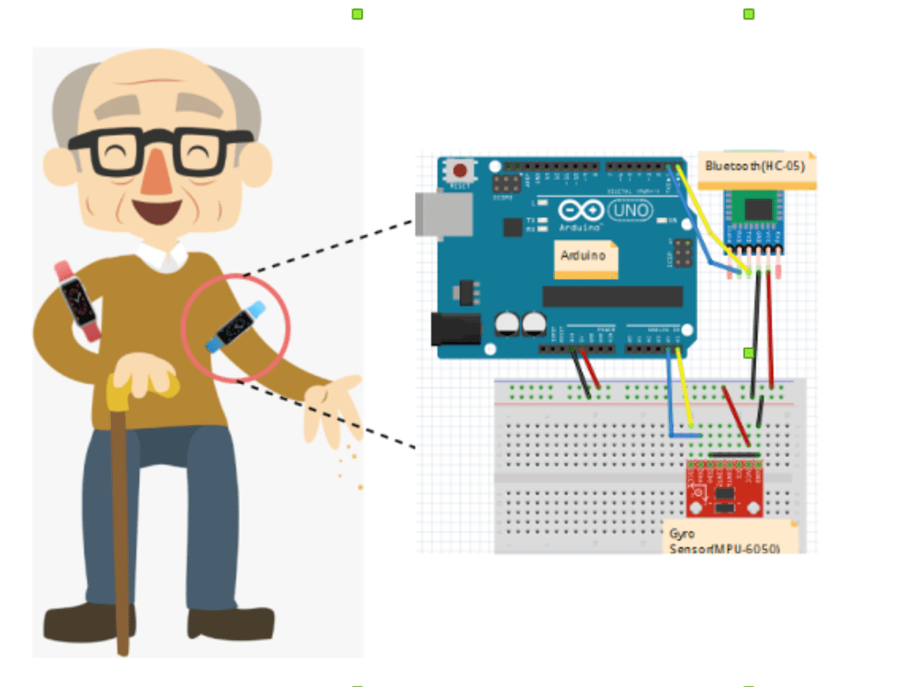
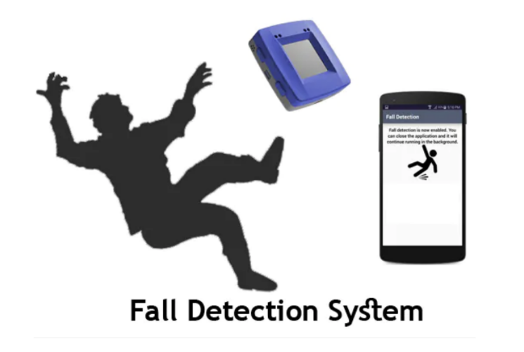
What can we do about it?
Part of the answer is in the data.
Efficient alert systems.

Slide 4
Methodologies and caveats
A classic ML classification task.
Falls are stochastic in nature.
Difficult to emulate real falls through data.
Needs well curated dataset.
Reformulating the research question.
Can we detect falls as out of distribution data?

Slide 5
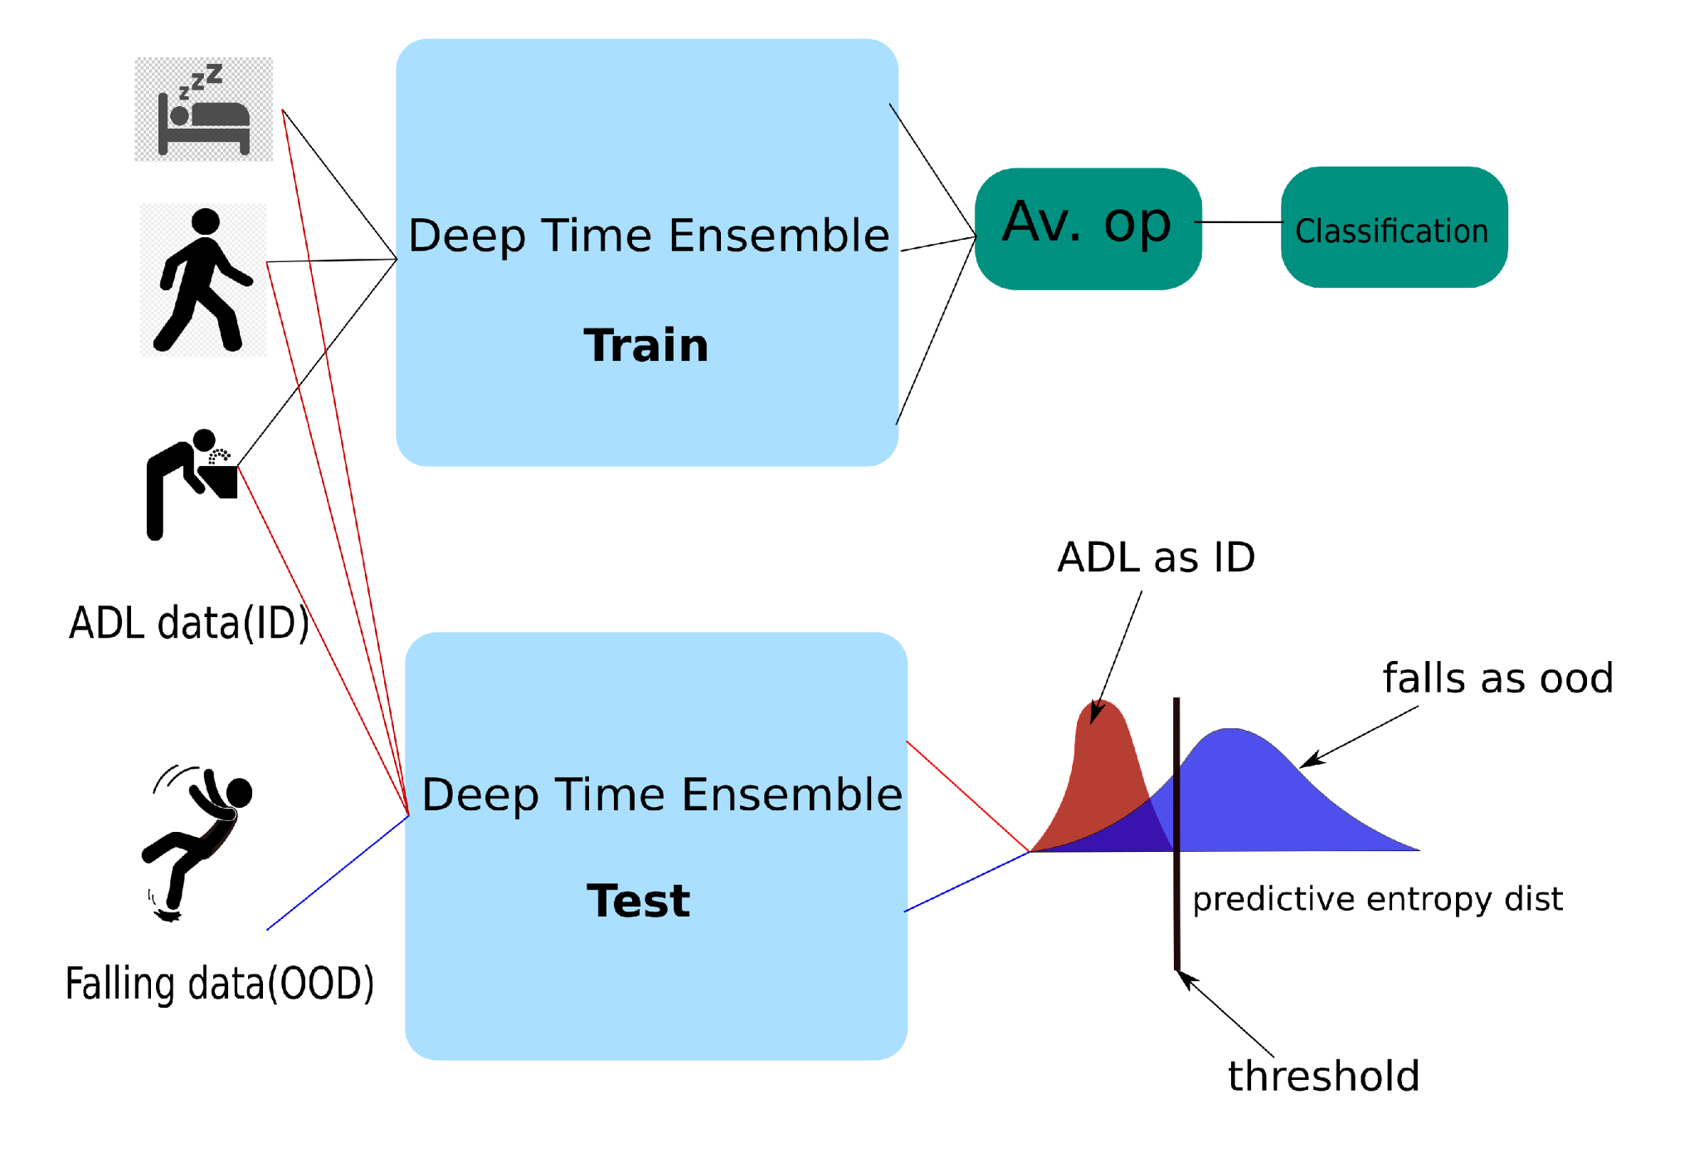
Our proposed method - Deep time ensembles [1][2]

Slide 6
And a lot more in the poster………

Slide 7
References
Roy, Debaditya, Vangjush Komini, and Sarunas Girdzijauskas. "Out-of-distribution in Human Activity Recognition." 2022 Swedish Artificial Intelligence Society Workshop (SAIS). IEEE, 2022.
Roy, Debaditya, Sarunas Girdzijauskas, and Serghei Socolovschi. "Confidence-calibrated human activity recognition." Sensors 21.19 (2021): 6566.
https://www.who.int/news-room/fact-sheets/detail/falls.
https://www.cdc.gov/injury/features/older-adult-falls/index.html.
https://www.lively.com/health-and-aging/what-is-fall-detection/.

Slide 8
Beneficiaries / Partners
BENEFICIARIES
PARTNERS

Slide 9
Acknowledgement
This project has received funding from the European Union’s Horizon 2020 research and innovation programme under the Marie Skłodowska-Curie grant agreement Innovative Training Networks (ITN) - RAIS No 813162

Slide 10
Social
www.rais-itn.eu

Slide 11
THANK YOU!

